Slide 1
Components of the Computer System
+1 Computer Science

Slide 2
Data processing
It is the operation or activities performed on data to generate information
Data : number, words, amount, quantity
Information : meaningful and processed form of data. It adds to our knowledge and help to making decisions.
Data processing proceed through 6 stages
Capture data
Input of data
Storage of data
6. Processing / manipulating data
7. Output of information
8. Distribution of information

Slide 3
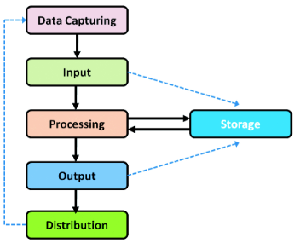

Slide 4
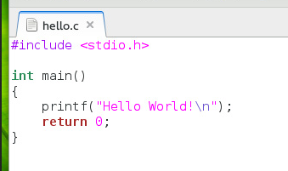
Data processing
Capturing Data
1st stage in data processing
Collect data in proper order and format by the help of source document
Source document : designed to provide data to the computer in collectable format

Slide 5
Input
2nd stage
Data collected through the source document is fed to the computer for processing

Slide 6
Storage
3rd stage
The input data are stored before processing
The information obtained processing may also stored
Example : RAM

Slide 7
Process
4rd stage
Operations like calculations, classifications, comparison, sorting, filtering, summarising, etc.. may be carried out as part of processing.
Example : processor / controllers

Slide 8
Output
5th stage
Processed data obtained in the form of information
This output may be stored for future use

Slide 9
Distribution of information
6th stage
Information is distributed to users/beneficiary
They take decisions / solve problems according to this information

Slide 11
Functional units of a computer
Mainly computer have 3 parts (v)
Input unit
Central processing unit
Output unit

Slide 12
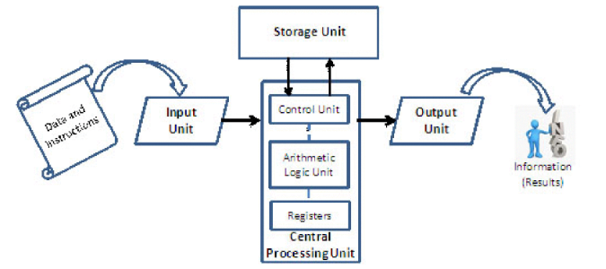
Storage Unit
Data & instructions
Input Unit
Control unit
Output Unit
Arithmetic Logic Unit
Information
(Result)
Registers
Central Processing Unit

Slide 13
Input Unit
Data & instructions for processing are entered to the computer through the input unit
They are stored in memory (storage unit)
Data format depends upon the nature of input device (number, text, video, audio, etc..)
Commonly used input devices : keyboard, mouse, scanner, mic, digital camera, etc..

Slide 14
Function of input unit
Accept instructions and data
Convert these instructions and data into computer acceptable form
Supplies the converted instructions and data for processing

Slide 15
Central processing unit (CPU)
Brain of computer
All the calculations and comparisons are made inside the CPU
Also responsible for activating and controlling of other units
CPU functions are performed by 3 components
ALU (Arithmetic Logic Unit)
CU (Control Unit)
Registers

Slide 16
ALU (Arithmetic Logic Unit)
Perform calculations and logical operations such as comparison and decision making
Working ALU
The data & instructions are transferred to the ALU and processing takes place in it.
Intermediate result temperedly stored back the storage and retrieve later.
Result is stored back to the storage unit

Slide 17
2. CU (Control Unit)
Central nervous system that manage and coordinates all other units
It obtain instructions from the program stored in the memory

Slide 18
3. Registers
Temporary storage element
A processor register is a quickly accessible location available to a computer's processor
Each one is designed to store unique items (memory address, data, instructions, result, etc..)

Slide 19
Storage Unit
Data and instructions are stored before processing
Also the information or result after processing are stored
Functions of storage unit are
Store data & instructions required for processing
Store intermediate results for ongoing processing
Store Final result

Slide 20
Storage units are of 2 types
Primary storage
Secondary storage

Slide 21
Primary storage
Also called main memory
CPU can directly access the main memory at very high speed
Limited storage capacity
Classified into 2
1. RAM (Random Access Memory) :
Used to hold instructions, data & intermediate results of processing
2. ROM (Read Only Memory) :
Used to hold Instruction for the start-up procedure of the computer

Slide 22
2. Secondary storage
Also called Auxiliary storage
Huge storage capacity
Store data permanently
Examples : Hard Disk, CD, DVD, Flash drive

Slide 23
Output Unit
Processed data supplied to the outside world
Human-readable form
Examples: Monitor, Speaker, Printer
Functions of Output unit are
Receive the result from CPU in coded form
Convert the coded result to human readable form
Supplies the result to the outside world

Slide 25
Hardware
Touchable and visible part of a computer
Processor
Motherboard
Peripherals and Ports
Memory
Input / Output devices

Slide 26
Processor
It is an integrated circuit (IC) package consist of millions of transistors and other components fabricated into a single chip
Also called Microprocessor
Responsible for all calculations , Decision making operations and coordinate the working of the computer
Example: Intel core i3, core i5, core i7, AMD Quadcore,etc..

Slide 27
Registers are located inside the processor
Important registers are :
A (Accumulator)
MAR (Memory Address Register)
MBR (Memory Buffer Register)
IR (Instruction Register)
PC (Program Counter)

Slide 28
A (Accumulator) :
Part of ALU
Used to store intermediate result
Also called Register A
MAR (Memory Address Register)
Store the address of memory location by the processor
MBR (Memory Buffer Register)
It hold data read from the memory by the processor

Slide 29
4) IR (Instruction Register)
Executed instructions are stored by the processor
5) PC (Program Counter)
It hold the address of next instruction to be executed by the processor

Slide 30
Motherboard
Large Printed Circuit Board (PCB)
The board consisting of additional expandable slots for memory, graphics card, sound card, etc..

Slide 31
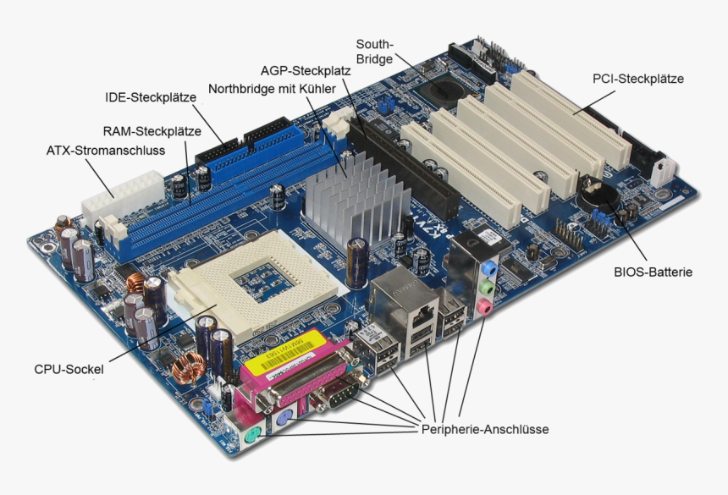

Slide 32
Peripherals and ports
Peripherals : external devices are connected to the computer.
Input/output device, Communication device, Memory device
Ports : slots on motherboard used to connect external devices.
VGA, PS/2, USB, Ethernet, HDMI

Slide 34
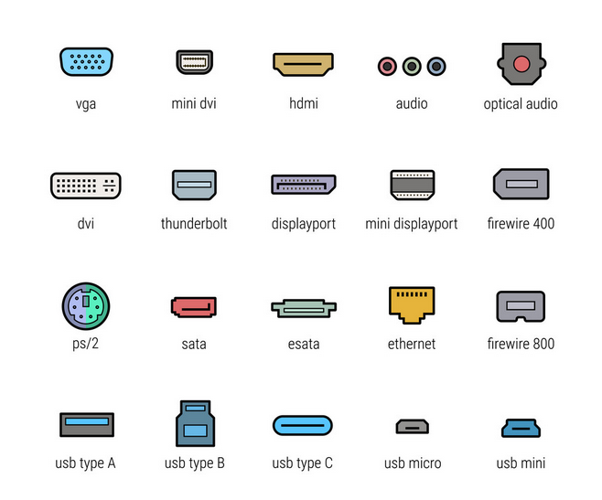

Slide 35
Memory
Used to store data, instructions and information's(results) temporally or permanently.
Memory classified into 2
Primary Memory (store data / intermediate results temporally)
Secondary memory (store data / results permanently)

Slide 36
Different memory measurement units:
Binary digit = 1 Bit
1 Nibble = 4 Bit
1 Byte = 8 Bit
1 KB (Kilo Byte) = 1024 Bytes
1MB (Mega Byte) = 1024 KB
1 GB (Giga Byte) = 1024 MB
1TB (Tera Byte) = 1024 GB
1PB (Peta Byte) = 1024 TB
1
1
0
1
1
1
0
1
1
1
0
1
1

Slide 37
1. Primary Storage
Semiconductor memory accessed directly by the CPU
Capable of sending & receiving data at high speed.
It include 3 type of memory
RAM
ROM
Cache memory

Slide 38
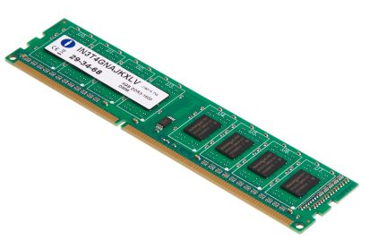
RAM
Microprocessor can directly access
Support Read & write Operations
Data or instructions to be processed by the CPU must be placed in RAM
Volatile memory
Data lost when power off
Speed measure in Mega Hertz (MHz)
A working computer, the RAM contains:
Operating system software (OS)
Currently used Application Software
Data being processed

Slide 39
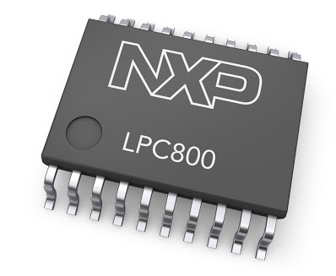
2) ROM
Only Read Operation
Non Volatile memory
Data cannot lose when power off
ROM contains:
Boot Up Program
BIOS (Basic Input Output System)

Slide 40
ROM Types
PROM (Programmable ROM)
Programmed only 1s time
Rewritten not possible
EPROM (Erasable Programmable ROM)
rewritten using ultra-violet radiation
EEPROM (Electrically Erasable Programmable ROM)
rewritten electrically

Slide 41
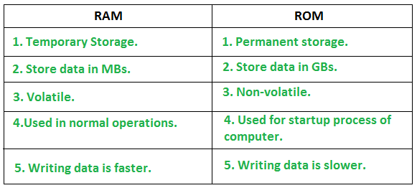
Difference between RAM & ROM

Slide 42
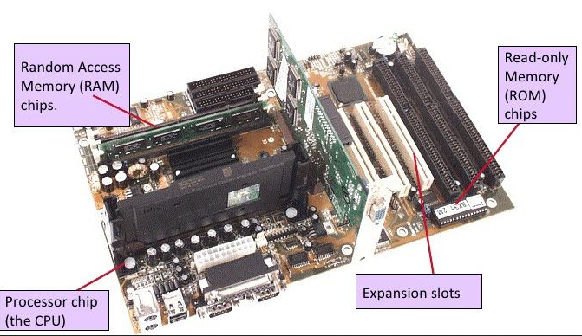

Slide 43
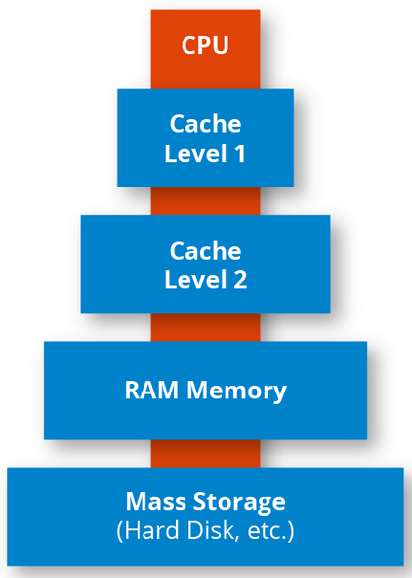
3) Cache Memory
Small & Fast memory between processor and RAM
Frequently asked data, instructions, intermediate results, etc… are stored in cache memory.
This memory make faster the entire working of the computer
Reduce hanging problems.
Cache is more expansive than ROM

Slide 44
1. Secondary Storage (Auxiliary Storage)
Permanent storage device
Store program and data
Also used for transferring data or program from one PC to other
Processor cannot access directly.
Non volatile memory
Cheaper & Slower than RAM
Categories:
Magnetic storage device
Optical storage device
Semiconductor storage

Slide 45
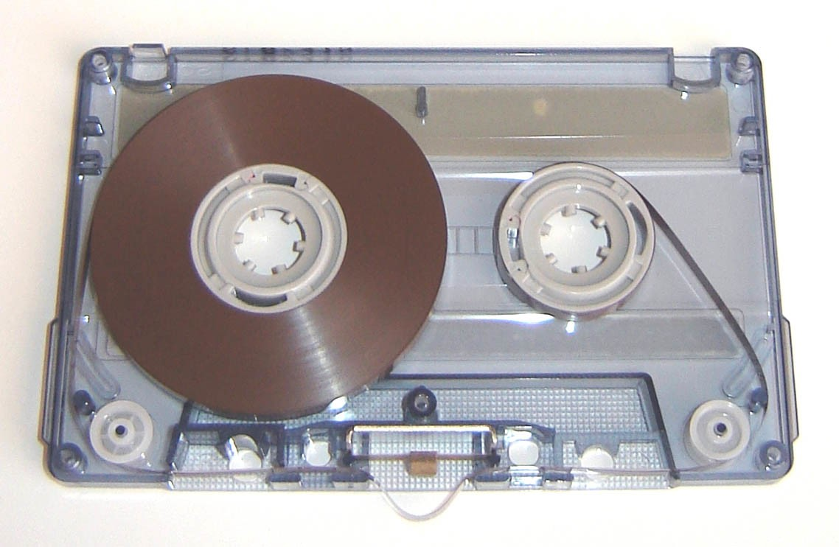
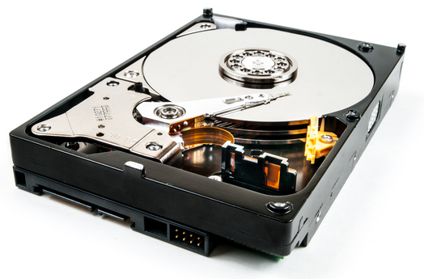
Categories:
Magnetic storage device
Magnetic Tap , Hard disk
Data Recorded magnetically in this devoice
Read write header is used to access data

Slide 46
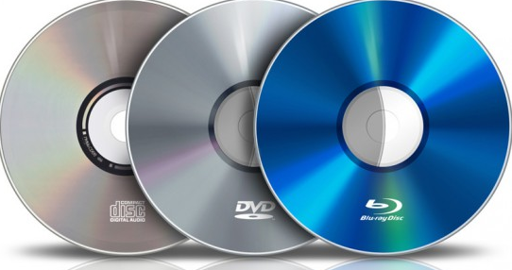
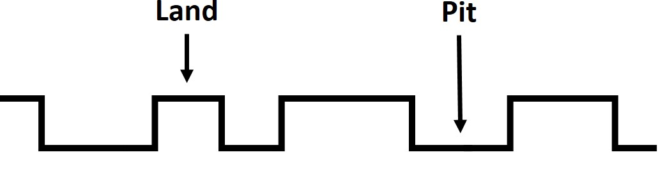
2. Optical storage device
CD, DVD, Blu-Ray
Data read and write using laser beam
Aluminium foil between 2 plastic disk
Laser beam read pits and lands as 0s and 1s

Slide 47
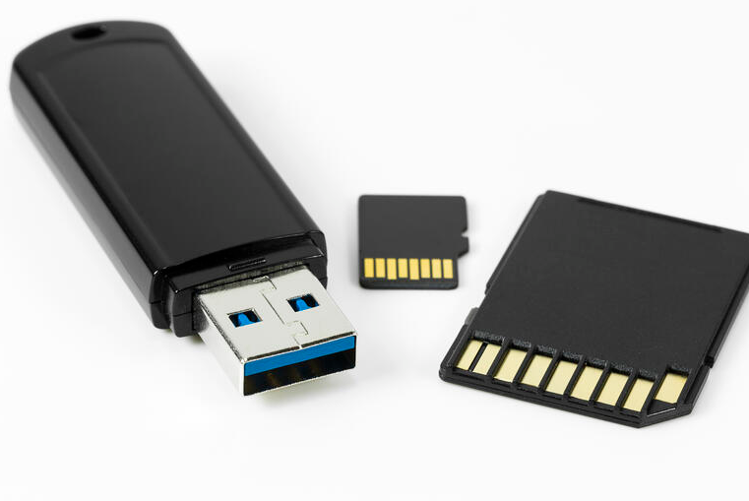
3. Semi-conductor storage
Flash drive, SD Card
Made by EEPROM Chip
Long life

Slide 48
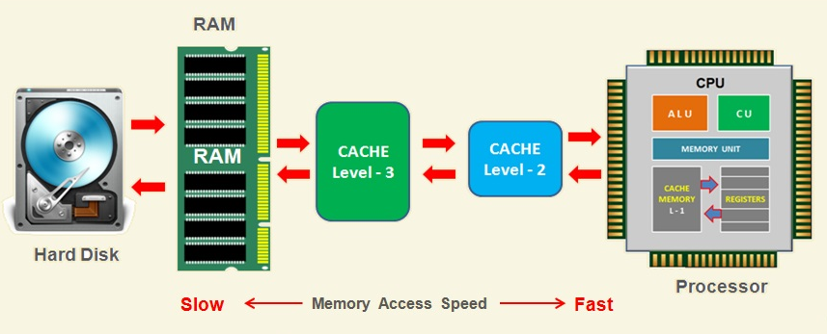
Role of memories in Computer
Memory increase the performance of a computer
Memory Hierarchy

Slide 49
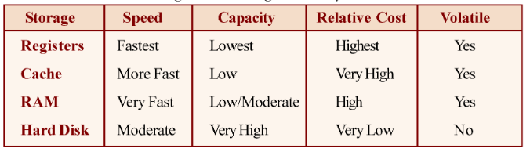
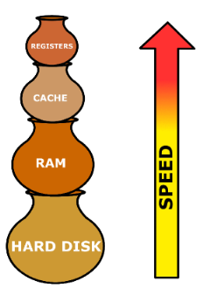
Characteristics of different types of memory

Slide 50
Input / Output devices
Human communicate with computer
Input Devices
Keyboard
Mouse
Light pen
Touch screen
Graphics table
Joystick
Microphone
Scanner
Optical Mark reader (OMR)
Barcode reader
Biometric reader
Smart card reader
Digital camera

Slide 51
Input / Output devices
Output Devices
VDU (visual Display Unit)
LCD
Printer
Plotter
3D Printer
Audio Output Device

Slide 53
E-Waste
Electronic waste
Refers to electronic products nearing the end of their ‘useful life’
Discarded computer, office electronic equipment, entertainment device, Mobile phones, TV, Refrigerator,
Used-products are also considered as e-waste.

Slide 54
Why should we be concerned about e-waste ?
E-waste contain very toxic substances
Mercury
Lead
Cadmium
Brominate flame retardants
The toxic materials can cause
Cancer
Reproductive disorders
Many other health problems like asthma

Slide 55
e-waste side effects
Mercury
PCB & LCD Screen back light
baby’s - brain growth & nerve system
Adults - organ damage, mental problems etc..
Lead
PCB & Monitor glass
Central nerve system, blood system, kidneys
Cadmium
IC, Resistor, semi-conductors
Various type of cancer, Kidney problems
Brominate flame retardants
PCB, some Plastic
Toxin increase the risk of cancer

Slide 56
e-waste disposal methods
Reuse
Second-hand use / Upgrade / modified.
Flaming
Burn in specially designed centre at high temperature (900°C – 1000°C)
Recycling of e-waste
Making or manufacturing new product
Monitor, keyboard, laptop, telephone, hard disk, printer, IC’s are recyclable
Land filling
Widely used and non recommended method

Slide 58

Green Computing / Green IT
Green computing is the designing, manufacturing, using & disposing of computer and associated components efficiently and effectively with no impact on environment
Energy Star
Conceived by EPA (Environmental protection agency) in 1992
Promote energy efficiency in hardware standardisation

Slide 59
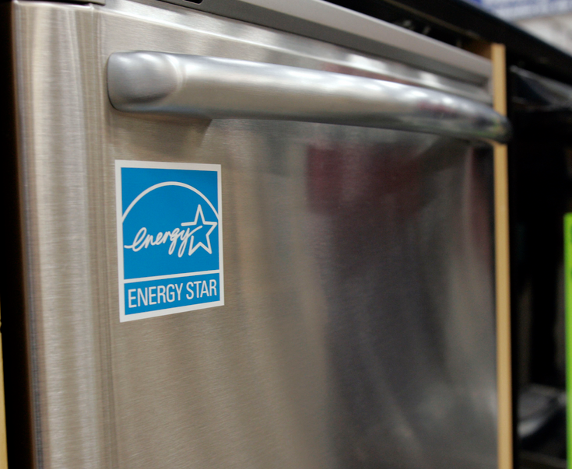
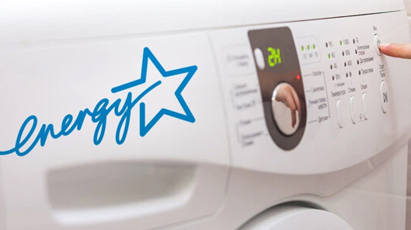

Slide 60
Govt regulations
Modify computer users / workers habits
Turn off computer when not In use
Power on peripheral device only when needed
Use power saver mode
Use laptop rather than desktop
Take print out only if necessary
Use LCD rather than CRT monitor
Use Hardware/software with Energy star label
Use solar energy

Slide 61
How to make computer green
Green design :
design energy efficient & eco-friendly computers, servers, printers, projectors and other digital devices .
Green manufacturing :
Minimising the waste during the manufacturing of devices
Green use:
Minimise the electricity consumption of computer and other devices
Green disposal :
Reconstructing used computers & properly dispose or recycle unwanted electronics equipment's.

Slide 63
Software
Software is a collection of data or instructions that tell the computer how to work.
2 types of software
System software
Application software

Slide 64
System Software
Set of programs designed to control the operations of a computer.
It Support the running of other software's.
It communication with other peripheral devices.
Use :
Controlling the operation
Move data into out of PC
User interface with hardware

Slide 65
User
Language Processors
Utility Software
Application Software
Operating System
Software
CPU
RAM
I/O
Hardware

Slide 66
Components of system software
Operating system
Language processors
Utility software

Slide 67
1) Operating system
Set of program that act as an interface between the user and computer hardware
OS provide an environment for user to execute programs
OS Control and coordinate the operations of a computer.
Important system software

Slide 68
Functions :
Process management : take care of allocation & de-allocation processes
Memory management : management of primary memory
File management : file related activity – naming, sorting, sharing, recovery…
Security management : management of device attached to the computer
Commands interpretation : understand and execute commands
Examples :
windows xp / 7 / 8 / 10, Linux, Ubuntu, Raspbian etc…

Slide 69
2) Language processors
Computer language classified into 3
Machine language
Assembly level language
High level language
Low level language

Slide 70
Machine Language
Binary digits : 0s and 1s
Fast execute in machine
Difficulty in humans
Error detection and corruption is not possible
Programmer must study computer architecture
01101000 01100101 01101100 01101100 01101111 00100000 01110111 01101111 01110010 01101100 01100100
hello world
s = a + b
01110011 00111101 01100001 00101011 01100010

Slide 71
Assembly Language
Intermediate level language
It is Mnemonic : symbolic name give to an operation
: ADD , SUB, ADC
Easier than machine language
Error detection and corruption is possible
Programmer must study computer architecture
LDA 2000
MOV B, A
LDA 2001
ADD B
STA 3050
HLT

Slide 72
High Level Language
English like language
Easier than Assembly language
Programmer no need to study computer architecture
Error detection and corruption is very easy
But computer cannot understood the HLL.
Compiler / interpreter used ( Language translator )
Convert HLL to MLL
Examples : BASIC, C, C++, Java, Python

Slide 73
Type of language processor
Assembler :
translate Assembly language to machine language
Program can be executed only after translation
Interpreter :
Another kinds of language processor
HLL - MLL line by line translation
Program can be executed only after translation
BASIC, Python

Slide 74
Compiler:
Another kinds of language processor
It scan the program in a single run
If any error in program, compiler provide the list of errors
If no error, compiler generate an object file
C, C++, Pascal

Slide 75
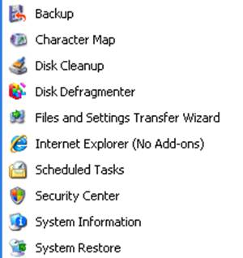
3) Utility software
Used to perform general system support and maintenance task
Task examples :
Detect & remove the computer virus
Disk management
Disk Formatting
Disk partition
Disk Clean-up etc…

Slide 77
Application Software
Software developed for specific application is called application software
It include
General purpose software package
Specific purpose software

Slide 78
1) General purpose software package
Used to perform tasks in a particular application area
Classified as :
Word processing software
Spreadsheet software
Presentation software
Database software
Multimedia software

Slide 79
1) Specific purpose software
Highly specialised software design to handle particular tasks.
Also known as customised software (developed for a single customer)
Some examples :
Payroll system : employee & salary details in a company
Inventory management system : tracking, orders, sales, deliveries…
Human Resource management system : managing human resource
Example : google pay, chess game, gmail, flipkart

Slide 81
Free & Open source Software
Gives the user the freedom to use, copy, distribute, examine, change and improve the software.
Now a days open software is widely used, reasons :
Acceptable activity
Less overall cost
Vendor independency (No intermediate sale persons)
security

Slide 82
Free Software Foundation (FSF)
FSF define 4 freedoms for free & open source software
To run program for any purpose
To study how to program works and adopt it to your needs
To distribute copies of the software
To improve the program and publish the change
Example : GNU / Linux , GIMP, Mozilla Firefox, OpenOffice.org

Slide 84
Freeware and Shareware
Freeware is the copyrighted software which is made available for use, free of cost, for unlimited period.
User cannot permit to change in the software
Example :
Google chrome
Skype
Avast antivirus
Adobe reader

Slide 85
shareware is the commercial software that is distributed on a trail basis.
Shareware gives users a chance to try before buying it.
All features are not available
Example :
Photoshop
Kaspersky antivirus
Winzip 7

Slide 87
Proprietary Software
Also known as Non-free software or close software
It Is a computer program that is an exclusive property of its developer or publisher
Cannot be copied or distributed without licensing agreements.
Example :
MS Windows
MS Office
Mac OS

Slide 89
Humanware or Liveware
Humanware is the Method of adding a human facet into the development of computer programs.
it is necessary for the proper functioning of hardware and software.
some humanwares :
System Administrator
System Managers
System Analysts
Network Administrator
5. Database Administrator
6. Computer Engineers
7. Computer Programmers
8. Computer Operators

Slide 91
Teaching materials Prepared by
RIDHUN DEV
Lecture IHRD College
+1 / +2 Computer Science
8089552581

